Slide 1

D MART SALES ANALYSIS
Between (2019-2022) Predicted Profit Or Loss
PREPARED BY AAKASH R

Slide 2

CONTENTS
01
Introduction
Points for discussion
02
Objective
03
Collecting The data
04
Prepreocessing The Data
O5
EDA Process

Slide 3

Time line Series
06
Model Selection
07
Predicting
08
Conclusion

Slide 4

DATA SOURCE
https://docs.google.com/spreadsheet s/d/165vRoweWpk_kUR0WNNuZZti1L 4AbmLsVxGc5PzJvxuk/edit#gid=0

Slide 5

INTRODUCTION
Bussiness Problem
As a Business manager, To find the product sales, loss or profit for the last 4 years. According to the predicted report the level of marketting is to be increased in the state of increasing the profit. Derive business problems by exploring the data

Slide 6

OBJECTIVES
Bussiness Solution
Identifying the sales percentage and evaluating the loss according to different states and promoting the marketting in particular states.
To identify more product sell by state and less product sell by state.
To identify more Product sold and less product sold.

Slide 7


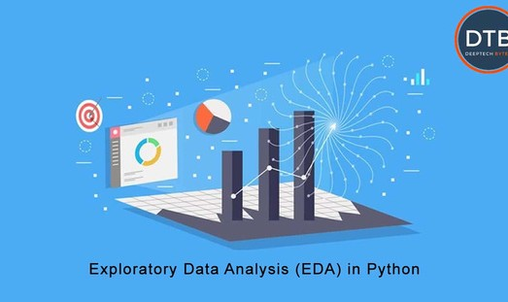
Machine Learning Process
Collecting the Data
Collecting data for training the ML model is the basic step in the machine learning pipeline. The predictions made by ML systems can only be as good as the data on which they have been trained.
Preprocessing The Data
Real-world raw data and images are often incomplete, inconsistent and lacking in certain behaviors or trends. They are also likely to contain many errors. So, once collected, they are pre- processed into a format the machine learning algorithm can use for the model.
EDA Process
Exploratory Data Analysis (EDA) is an approach to analyze the data using visual techniques. It is used to discover trends, patterns, or to check assumptions with the help of statistical summary and graphical representations.

Slide 8
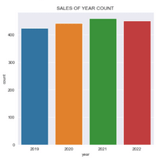
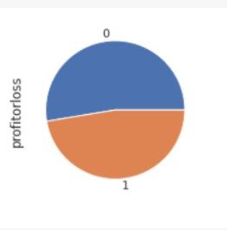
DATA VISUALIZATION
SALES COUNT BY YEAR
SALES COUNT BY PROFIT OR LOSS

Slide 9
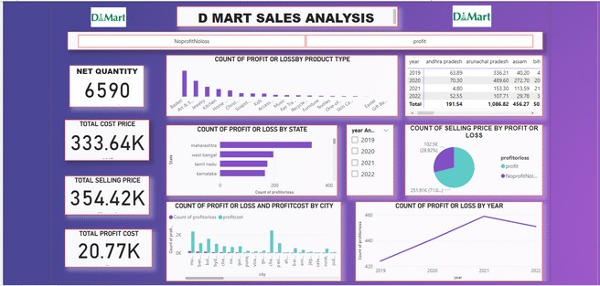
SALES ANALYSIS DASHBOARD USING POWER BI

Slide 10
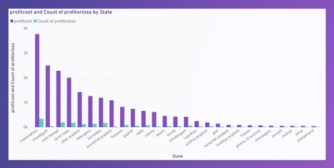
COUNT OF PROFIT COST AND PROFIT OR LOSS BY STATE

Slide 11


MODEL SELECTION
₀₁ DECISION TREE REGRESSOR
RANDOM FOREST REGRESSOR
02
03 ARIMA MODEL

Slide 12
ARIMA MODEL
ARIMA is a form of regression analysis that indicates the strength of a dependent variable relative to other changing variables.
DECISION TREE REGRESSOR
It is used for regression problems where you are trying to predict something with infinite possible answers such as the price of a selling price.
RANDOM FOREST REGRESSOR
Random Forest Regression is a supervised learning algorithm that uses ensemble learning method for regression. Ensemble learning method is a technique that combines predictions from multiple machine learning algorithms to make a more accurate prediction than a single model.

Slide 13

PREDICTING MODEL
To predict model have been r2 score and mean squared error.
Time series forecasting occurs when you make scientific predictions based on historical time stamped data.
Making predictions about the future is called extrapolation in the classical statistical handling of time series data.

Slide 14

CONCLUSION:
To Analyze The datasets target Attribute is Profit or loss and To analyze between past 4 years "No profit No loss".
Major Our product Sold by Mumbai State and At uttarakhand was a sold By Less number of Products.
In Year 2020 Our Product are sold By More and In 2019 Product are sold By Less Numbers.Current Year Our product are sold More compare between last year.
The Product of Basket are More sold and Gift Basket Product are sold less.

Slide 15

Thank you for your time!
Feel free to reach out to us for any questions or concerns.

